Slide 1
MAR PROGRAMME Basic Statistics MAR 112
Daw Ei Ei Aye
Associate Professor
Department of Statistics
University of Co-operative and Management, Sagaing

Slide 2
Contents
Unit I - Introduction
Unit II - Presentation of Data
Unit III - Data Description
Unit IV - Statistical Estimation
Unit V - Hypothesis Testing
Unit VI - Correlation and Simple Linear Regression Analysis

Slide 3
UNIT I INTRODUCTION
1.2 Definitions of Statistics
There are various definitions of statistics.
1. Statistics (plural) are a collection of numerical facts or data.
2. Statistics (singular) is the science of collecting, organizing, presenting, analyzing and interpreting data to assist in making more effective decisions.
3. Statistics is the science of gaining information from numerical data.
4. Statistics is the science of conducting studies to collect, organize, summarize, analyze, and draw conclusions from data.

Slide 4
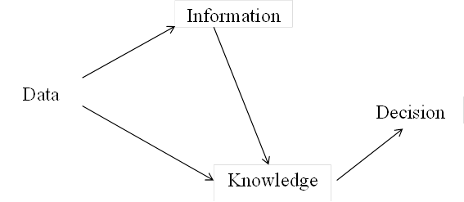
Data Manipulation

Slide 5
Why Study Statistics?
(a) Data are everywhere
(b) Statistical techniques are used to make decisions that affect our lives
(c) No matter what your future line of work, you will make decisions, that involve data
Who Uses Statistics?
Statistical techniques are used extensively by marketing, accounting, quality control, consumers, professional sports people, hospital administrators, educators, physicians, etc.

Slide 6
1.3 Statistical Terms
Variable
A variable is a characteristic or attribute that can assume different values.
Data
Data are the values (measurements or observations)
A collection of data values forms a data set. Each value in the data set is
called a data value or a datum.

Slide 7
Data Type in Econometrics
1. Time-series Data
2. Cross-sectional Data
3. Panel Data

Slide 8
Main Area of Statistics
Descriptive statistics
Inferential statistics
Descriptive Statistics
- consists of the collection, organization, summarization, and presentation of data.
Inferential Statistics
- consists of generalizing from samples to populations, performing estimations and hypothesis tests, determining relationships among variables, and making predictions.

Slide 9
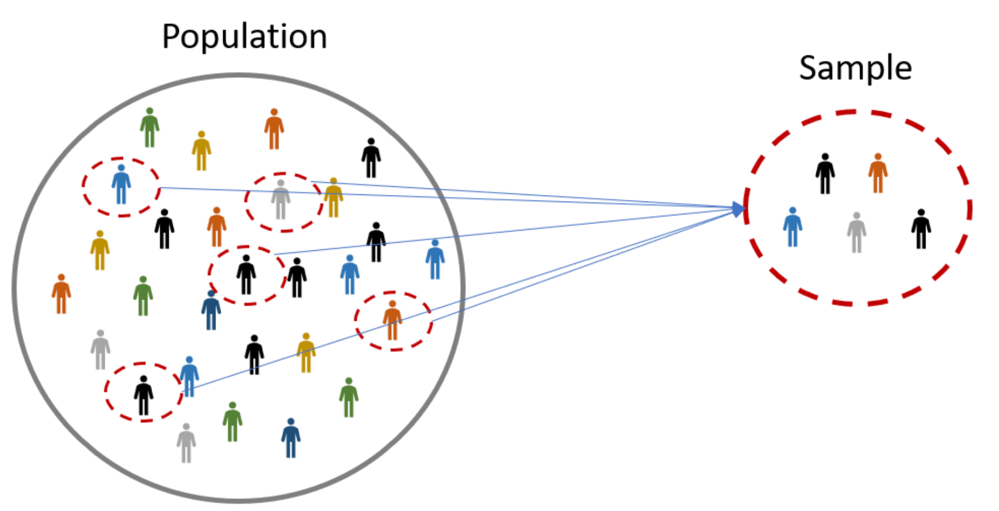
Population and Sample
Population: the entire group of individuals that a researcher wishes to study.
Sample: portion of a population that is selected for observation.

Slide 10
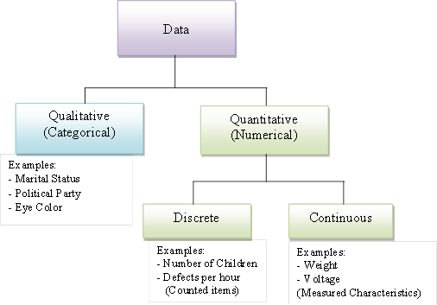
1.5 Variables and Types of Data

Slide 11
What do we know about the Dog?
Qualitative:
• He is brown and black
• He has long hair
• He has lots of energy
Quantitative:
Discrete:
• He has 4 legs
• He has 2 brothers
Continuous:
•He weighs 25.5 kg
•He is 565 mm

Slide 13
Some Examples of Measurement Scale
Nominal
Gender: Male, Female.
Hair Color: Brown, Black, Blonde, Red, Other.
Type of living accommodation: House, Apartment, Other.
Religious preference: Buddhist, Muslim, Jewish, Christian, Other.
25

Slide 14
Some Examples of Measurement Scale
Ordinal
•High school class ranking: 1st, 9th, 87th…
•Socioeconomic status: poor, middle class, rich.
•The Likert Scale: strongly disagree, disagree, neutral, agree, strongly agree.
•Time of Day: dawn, morning, noon, afternoon, evening, night.

Slide 15
Some Examples of Measurement Scale
Interval
•Celsius Temperature.
•Fahrenheit Temperature.
•IQ (intelligence scale).
•SAT scores.
Ratio
•Age.*
•Weight.
•Height.
•Sales Figures.
•Ruler measurements.
•Income earned in a week.
•Years of education.
•Number of children.

Slide 16
Sources of Data
Basis For Comparison | Primary Data | Secondary Data
Meaning | Primary data refers to the first hand data gathered by the researcher himself. | Secondary data means data collected by someone else earlier.
Data | Real time data | Past data
Source | Surveys, observations, experiments, questionnaire, personal interview, etc. | Government publications, websites, books, journal articles, internal records etc.
Cost effectiveness | Expensive | Economical
Collection time | Long | Short

Slide 17
Methods of Probability Sampling
Simple Random Sampling
သာမန်ကျပန်းနမူနာကောက်နည်း
Stratified Sampling
အလွှာခွဲနမူနာကောက်နည်း
Systematic Sampling
အကွာညီနမူနာကောက်နည်း
Cluster Sampling
အုပ်စုလိုက်နမူနာကောက်နည်း

Slide 18
Methods of Non Probability Sampling
Convenience Sampling
အဆင်ပြေနမူနာကောက်ခြင်း
Purposive sampling (or) Expert sampling (or) Judgmental sampling
စိတ်ကြိုက်နမူနာကောက်ခြင်း
Quota Sampling
ခွဲတမ်းနမူနာကောက်ခြင်း
Referral sampling (or) Snowball sampling
မှီငြမ်းနမူနာကောက်ခြင်း
Voluntary response sampling
ဆန္ဒပြုနမူနာကောက်ခြင်း

Slide 19


